Slide 1
TOUR GUIDE

Slide 2
PRESENTERS:
Guide:
MADHUKAR RAO SASIDHAR
2010030362_M.RUSHITHA SRI
2010030436_K.DIMPLE
2010030438_K.SIRISHA

Slide 3
Abstract
Problem statement
GITHUB
PROTOTYPE
CONCLUSION
THANKYOU
TABLE
OF
CONTEnT

Slide 4


ABSTRACT
The main aim of this project is to provide services to the users who have registered in the site. The services regarding to city political, historical, conventional places, bus routes , business companies profile and jobs details. Smart city is a web-based product used to store the details of particular city and helps all the users who just visits our website. This site also provides all the services like Hotel booking for tourists, Ticket booking, Transport facility providing, business related information , marketing details, city news ,shopping detail. The website contains the complete information about particular city like places to be visited ,site maps, route maps, Business environment, Job portal, information about organization that provide transport, Hospitality and total history of the city .This website can be used by any person who is having general knowledge about internet.

Slide 5

PROBLEM STATEMENT
For people who want the trip planned entirely, who don’t want to use the filtering method of pen and paper or trace filtering tour guide helps them completely. The tour guide is a website that helps vacation goers plan out where to go and what to see based on their interests.

Slide 6
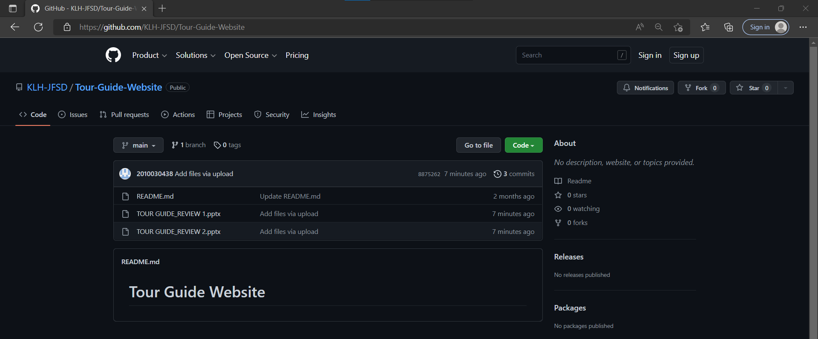
GITHUB:
https://GitHub - KLH-JFSD/Tour-Guide-Website

Slide 7

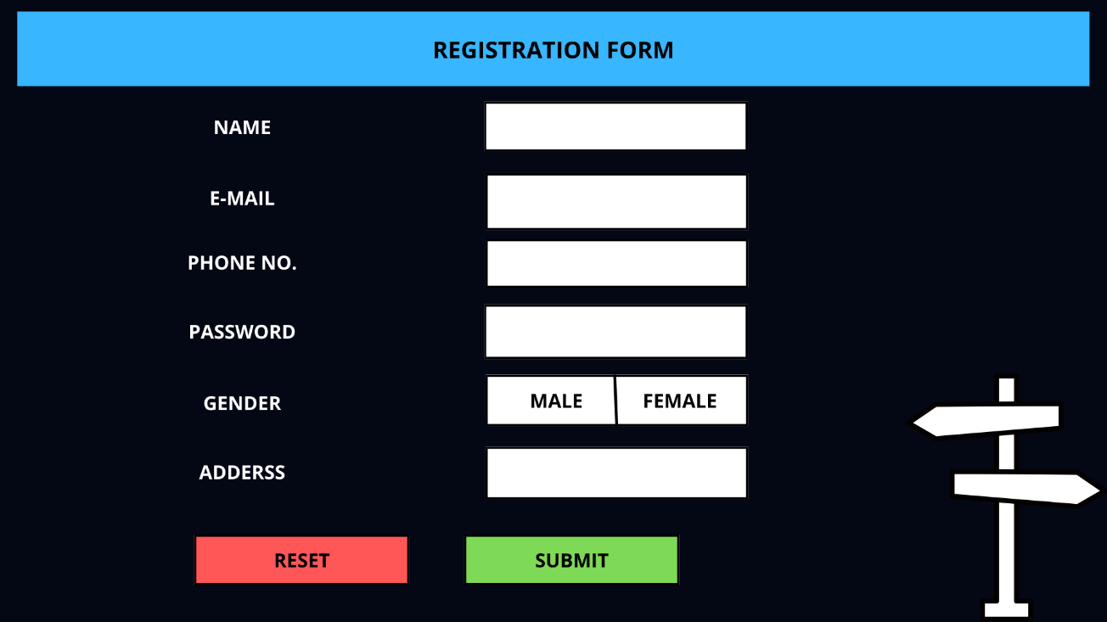
PROTOYTPE

Slide 8
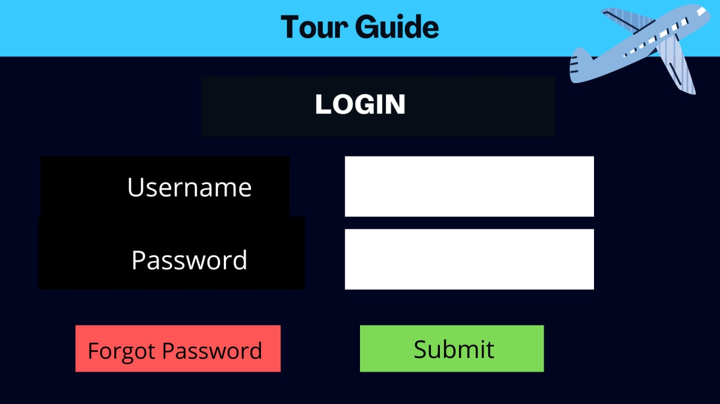
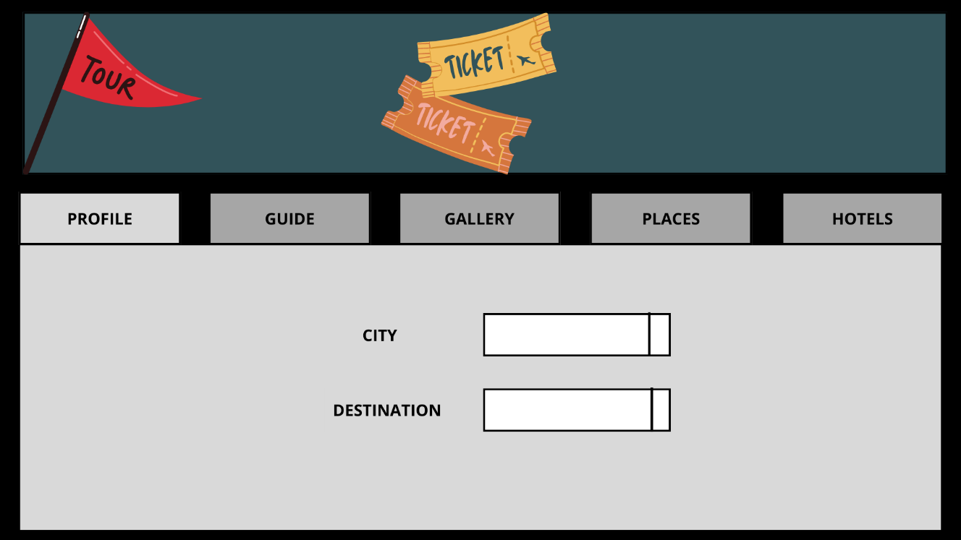

Slide 9


CONCLUSION:
The Website is to facilitate the offline customer online because customers cannot spend their precious time in markets trying to find out the best.

Slide 10


THANK
YOU

